Slide 1


Better UX with Popups
Kelly Hutchins
Heather Gonzago
2022 ESRI DEVELOPER SUMMIT
Notes:
2022 Esri Developer Summit

Slide 2

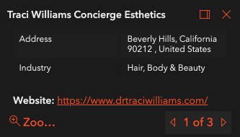
Map interaction
Display on mouse click
Display
Feature attributes
Search results
Location
Customizable

Slide 3
Popup in the API
View has default instance of Popup
Feature layer has associated Popup Template
Position the popup using dockOptions

Slide 4
Popup in the API
View has default instance of Popup
Feature layer has associated Popup Template
Position the popup using dockOptions

Slide 5
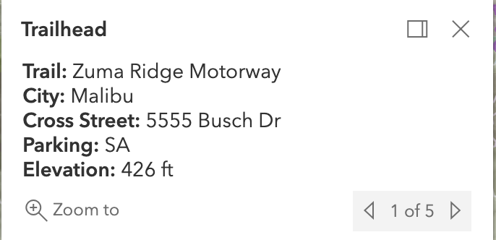
Getting Started
Popup Tutorial

Slide 6
Configure Popup Content
Popup Template
Title
Content
Elements

Slide 7
Content Element Types
Attachment Content
Text content
Fields content
Custom conten
tMedia content
Expression content

Slide 8
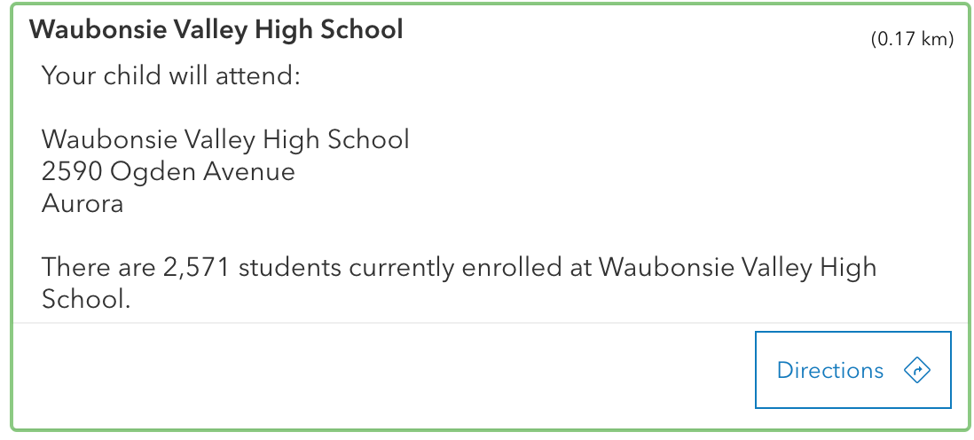
Actions
Basic
Per feature
Edit

Slide 9
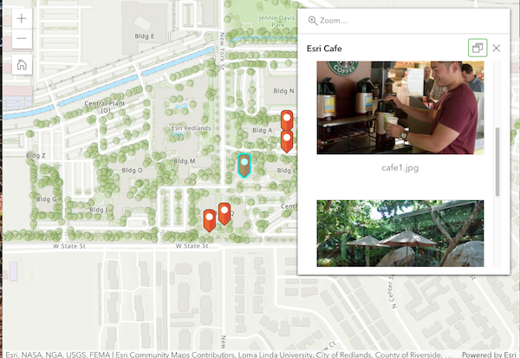
Build Popups in ArcGIS Online
webmap json
webmap json

Slide 10
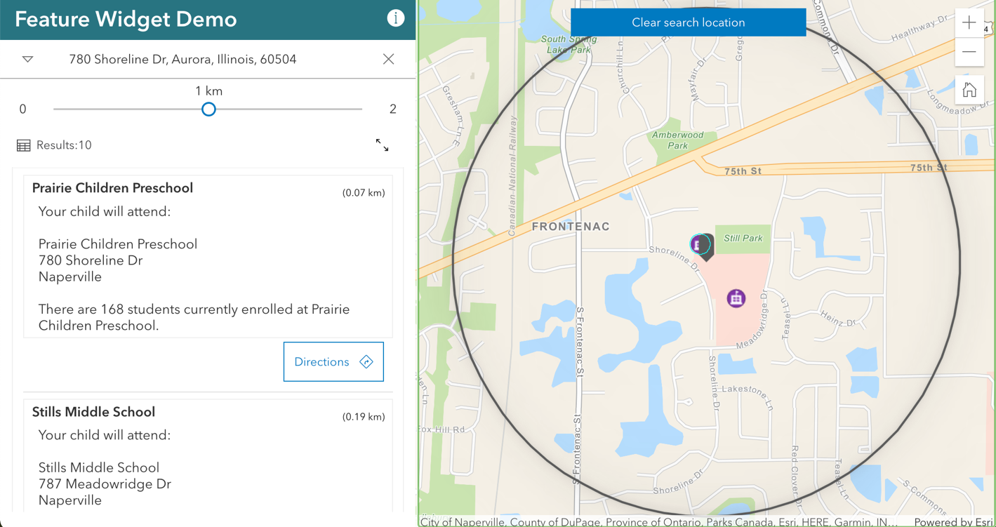
Feature Widget
Display Popup template content
Hover,
Side Panel
Accordion
Multiple features

Slide 11
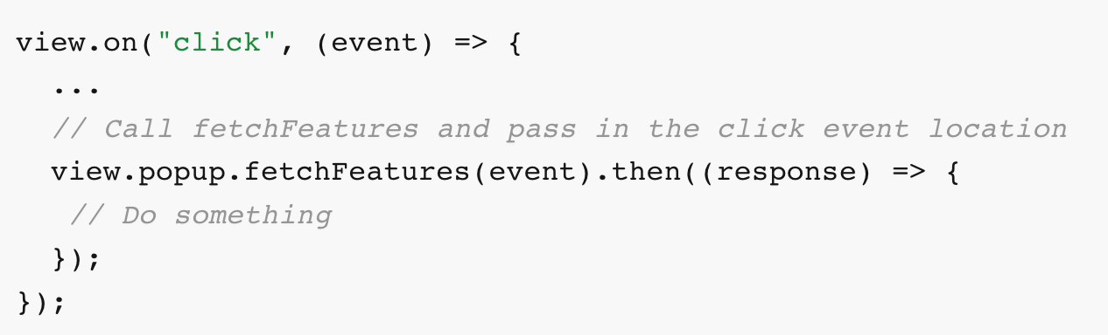
Feature Widget
fetchFeatures

Slide 12
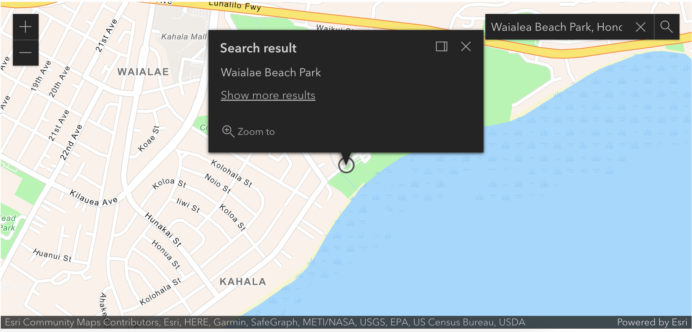
Style the Popup
Themes
Visible Elements

Slide 13
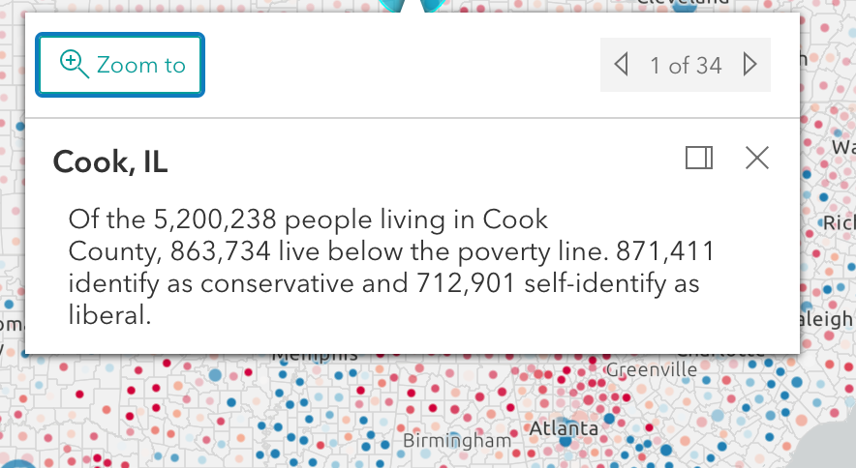
Style the Popup
Link to Sass file in doc
Styling guide
SASS
Custom Theme

Slide 14




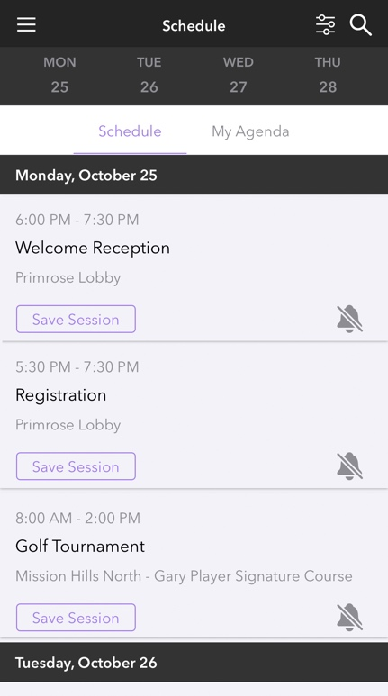

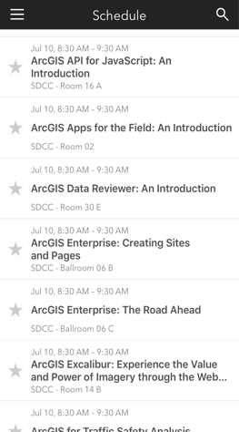
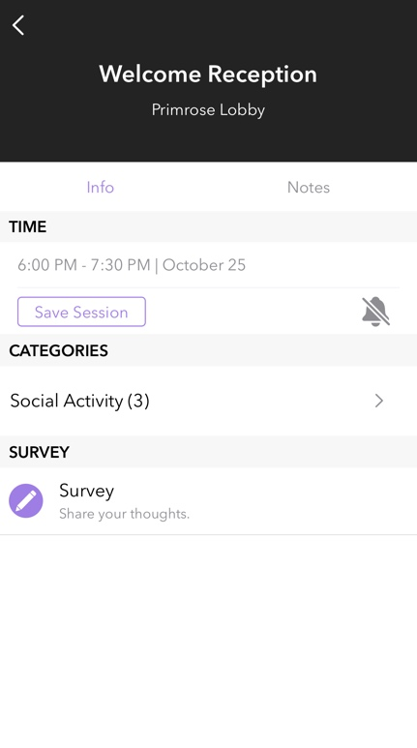

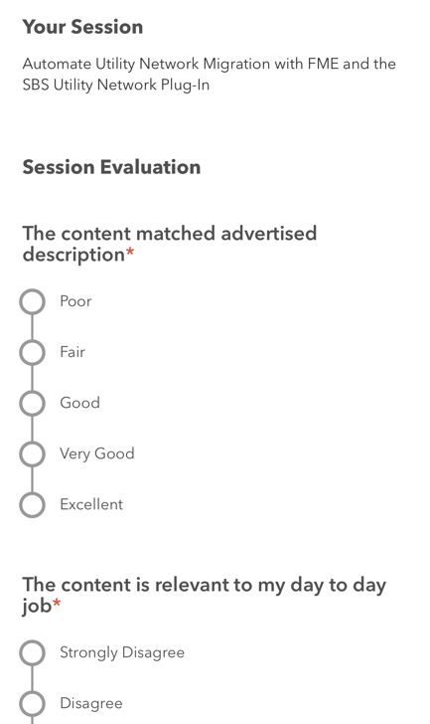
Please Share Your Feedback in the App
Download the Esri Events app and find your event
Select the session you attended
Scroll down to “Survey”
Log in to access the survey

Slide 15



Copyright © 2022 Esri. All rights reserved.

Slide 16
ArcGIS Online: Developing with Web Maps and Web Scenes
Kelly Hutchins, Jeremy Bartley, Ryan Libed
2022 ESRI DEVELOPER SUMMIT
Notes:
2022 Esri Developer Summit

Slide 17

Resources
Kelly Hutchins

Slide 18
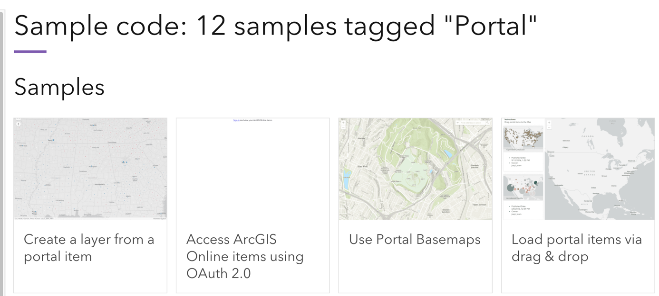
SDK Resources
Guide to working with ArcGIS Online
Code Samples
ArcGIS Developer

Slide 19
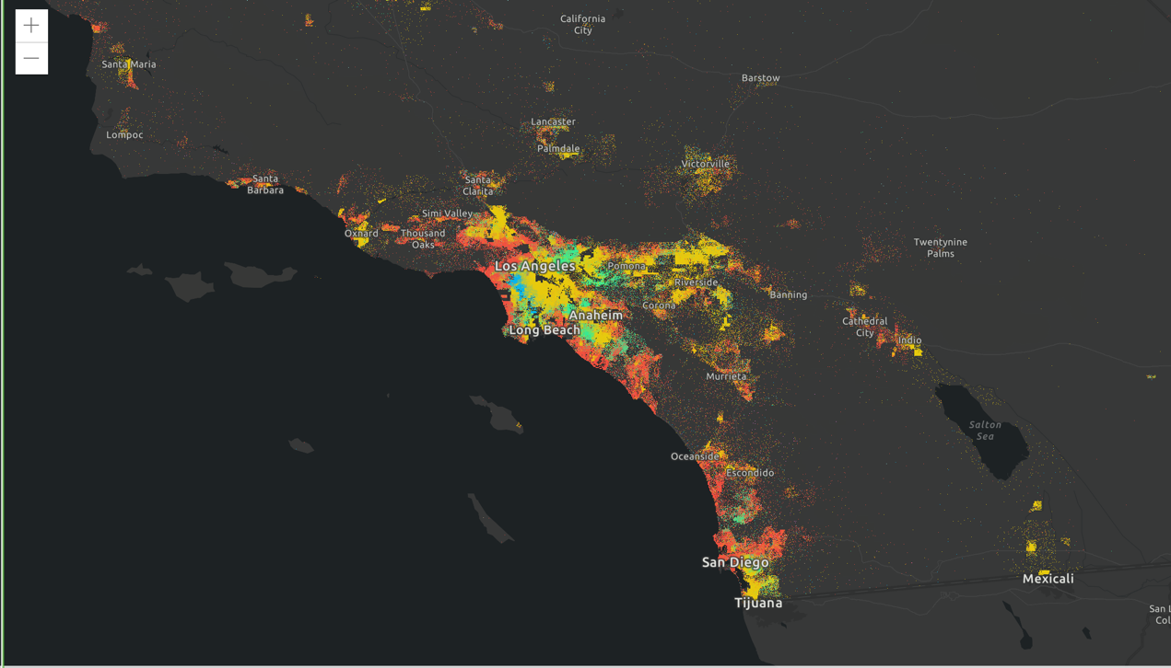
Map demo
Create map
Define symbology
Add layer
Define popup content

Slide 20
Web Map Demo
Create map in map viewer
Use web map id

Slide 21
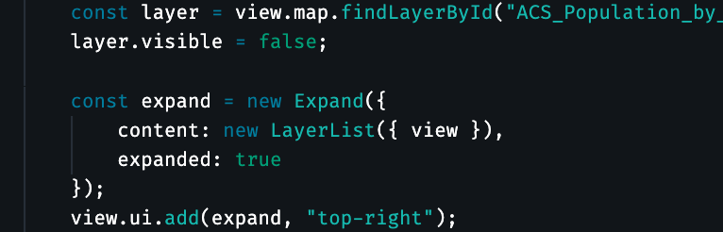
Accessing map content
Change map properties
Access layers
Add widgets and more

Slide 22
Headline
Subhead
Bullets

Slide 23

Section Header
Section Subhead

Slide 24

Portal
Ryan Libed

Slide 25
Widgets
Ryan Libed

Slide 26
Please Share Your Feedback in the App
Download the Esri Events app and find your event
Select the session you attended
Scroll down to “Survey”
Log in to access the survey

Slide 27
Copyright © 2022 Esri. All rights reserved.

